Slide 1

R Semester Project

Slide 2
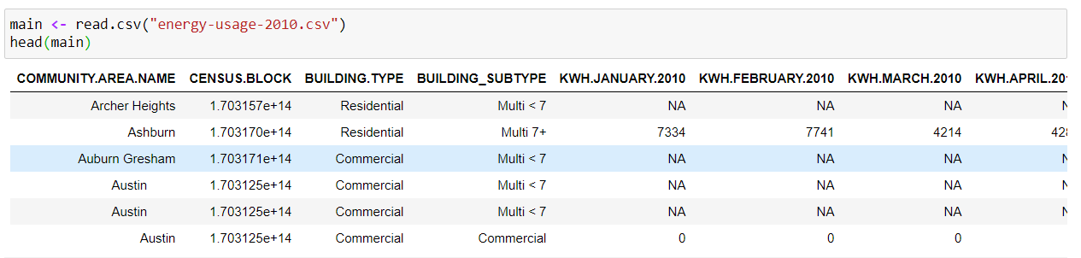
What is our dataset about?
Our Dataset is about the energy consumption in the state of Chicago in the year 2010. It basically contains the Electricity and Thermal(CNG or Heat) consumption of different households and Industries based on their geographical attribute

Slide 3
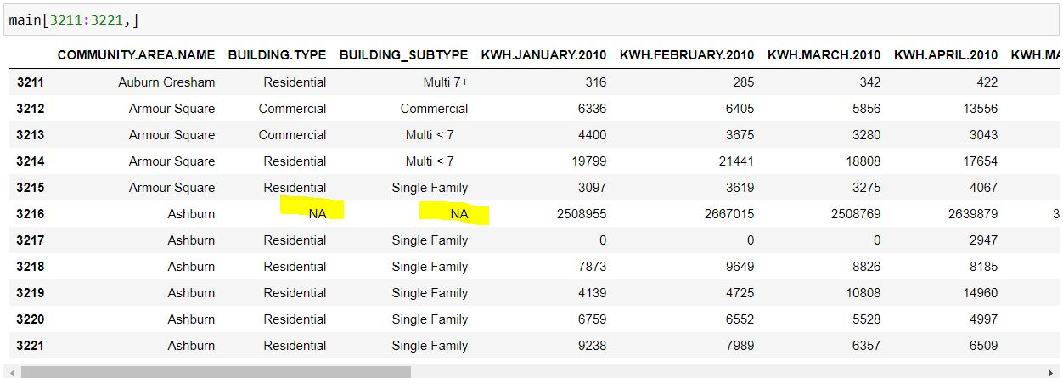
Cleaning the Data set
Categorical Data
The missing values in the categorical data have been filled with the values in the previous row.

Slide 4
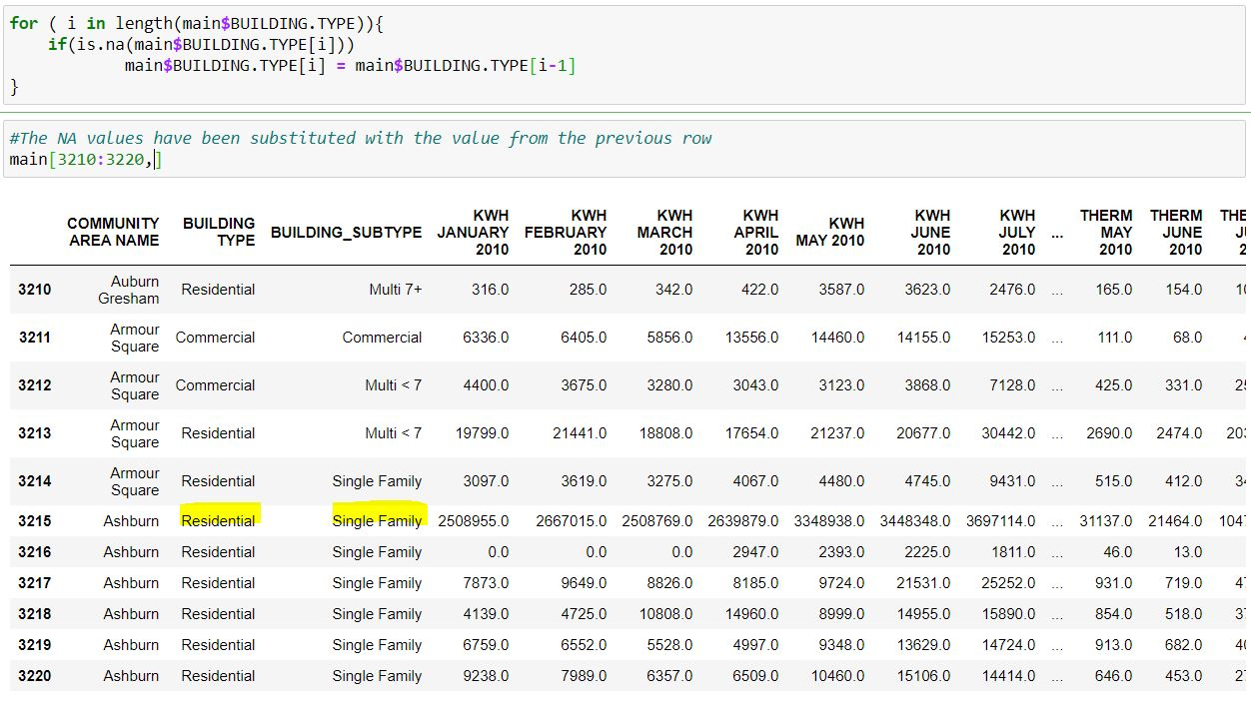
Cleaning the Data set

Slide 5
Cleaning the Data set
Filling the missing values(for Numerical)
The missing values have been filled with zeros. This is done because, if at all the values are missing it means there is
no usage of electricity or thermal.
Treatment of Outliers
The outliers in the electricity columns have been filled
with the average of that particular columns. While that
In the thermal section have been interpolated

Slide 6
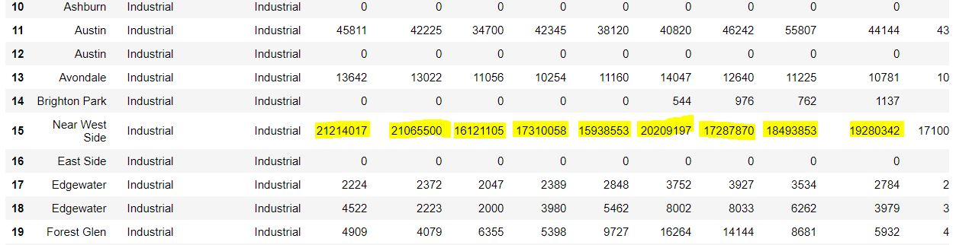
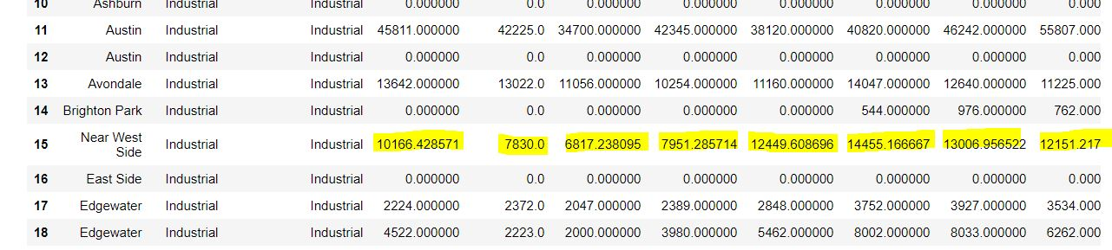
Examples

Slide 7
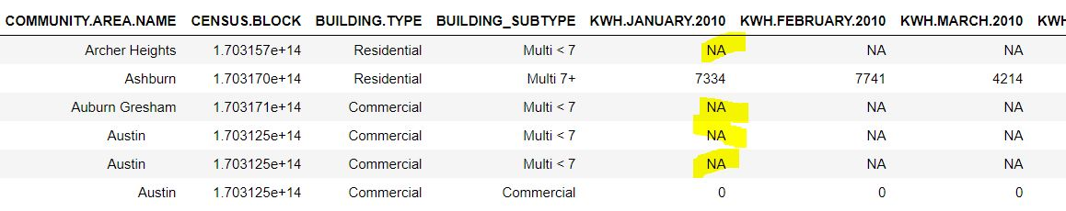
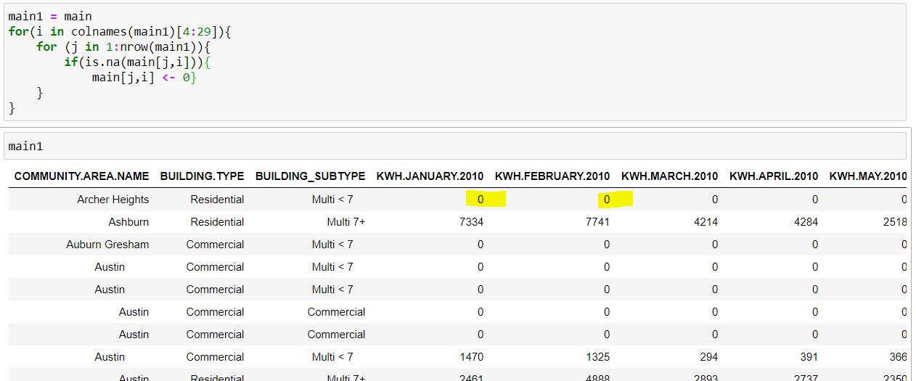
Examples

Slide 8
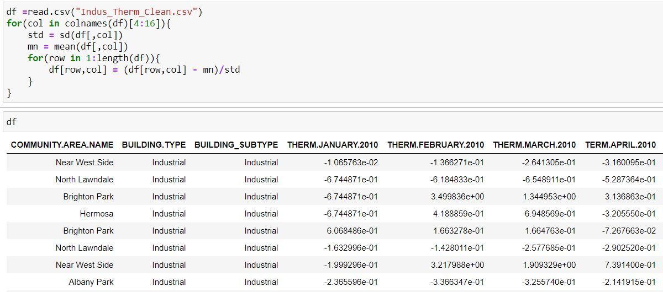
Normalization of Data
The data is standardized such that the mean of the row is 0 and the variance is 1. The mean and variance are only for those who have used the energy and not for everyone

Slide 9
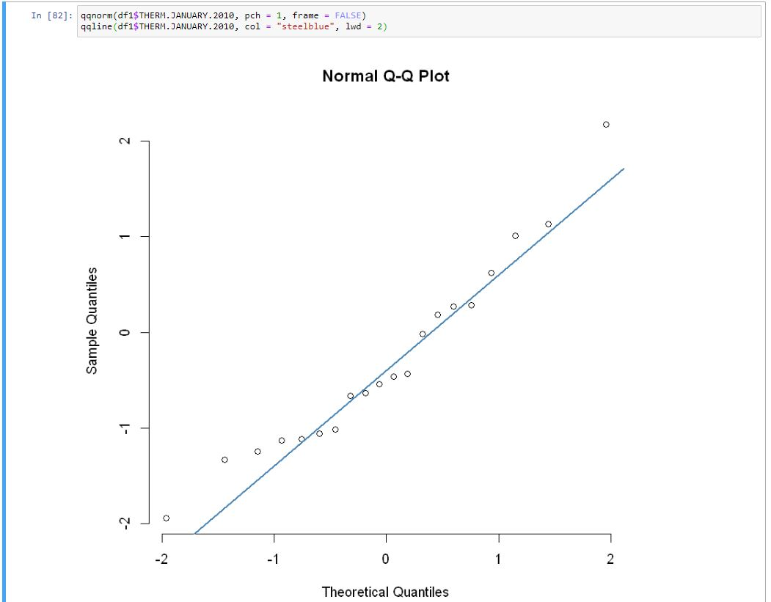
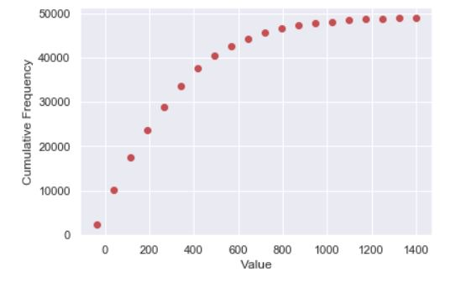
Proof that the data is normal
We can find out if the given data is approximately normal by plotting the quantile-quantile plot and the cumulative frequency plot.

Slide 10
Why Normalization? How does it affect the dataset?
Normalization helps in scaling the data. By doing this, we can comparing two separate columns. This can also be used for predictions
#FILL MORE

Slide 11
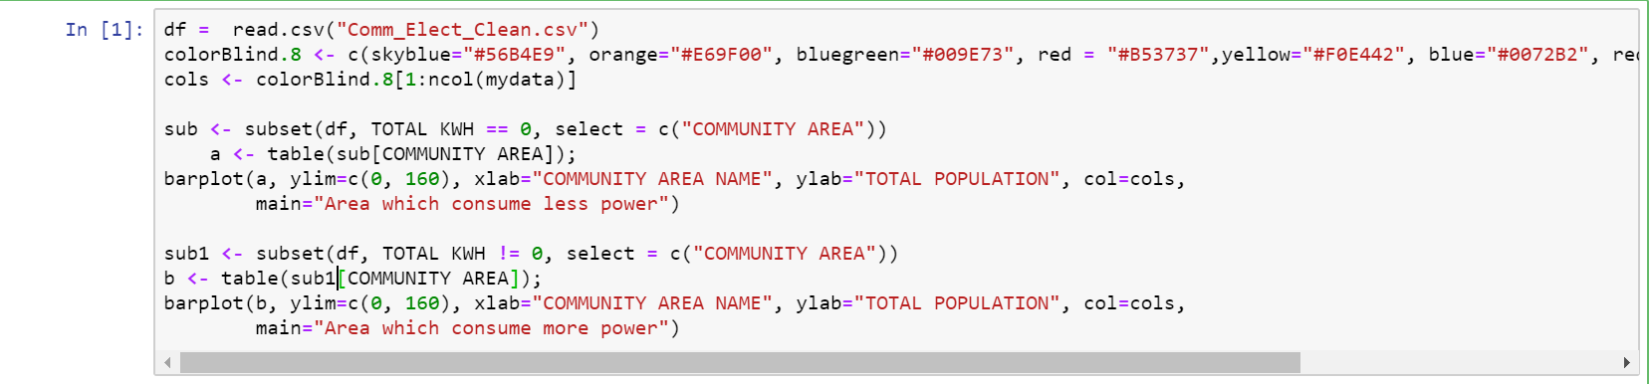

Slide 12
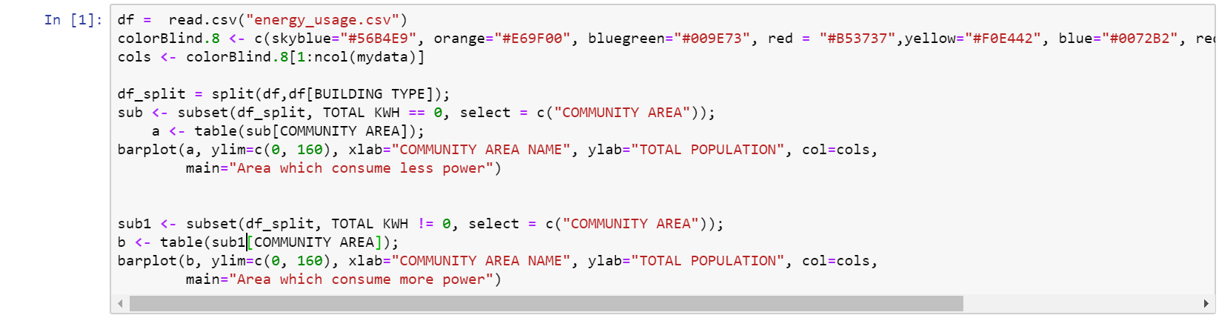

Slide 13
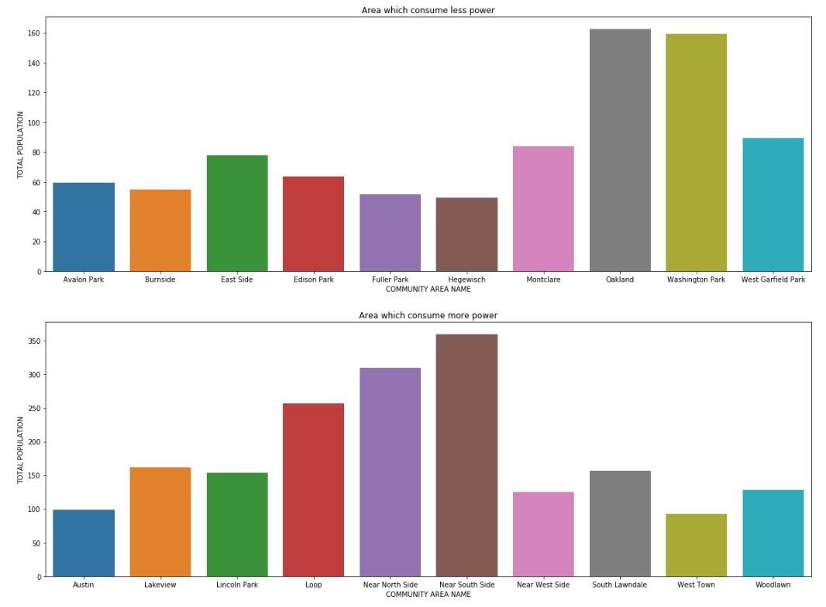

Slide 14
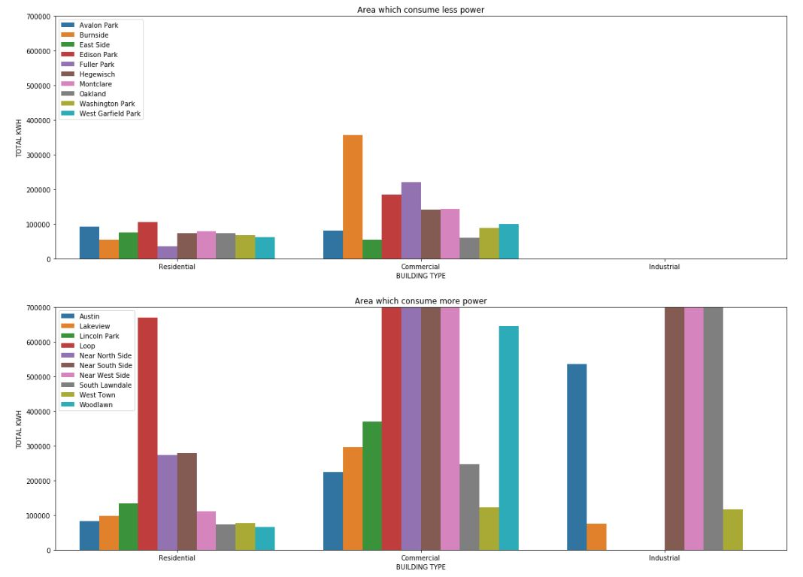

Slide 15
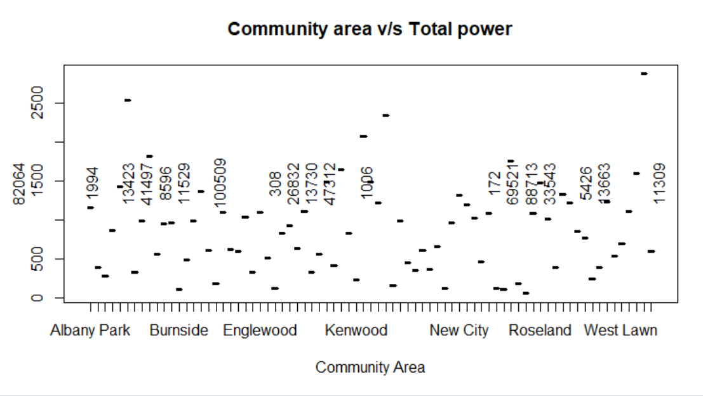

Slide 17
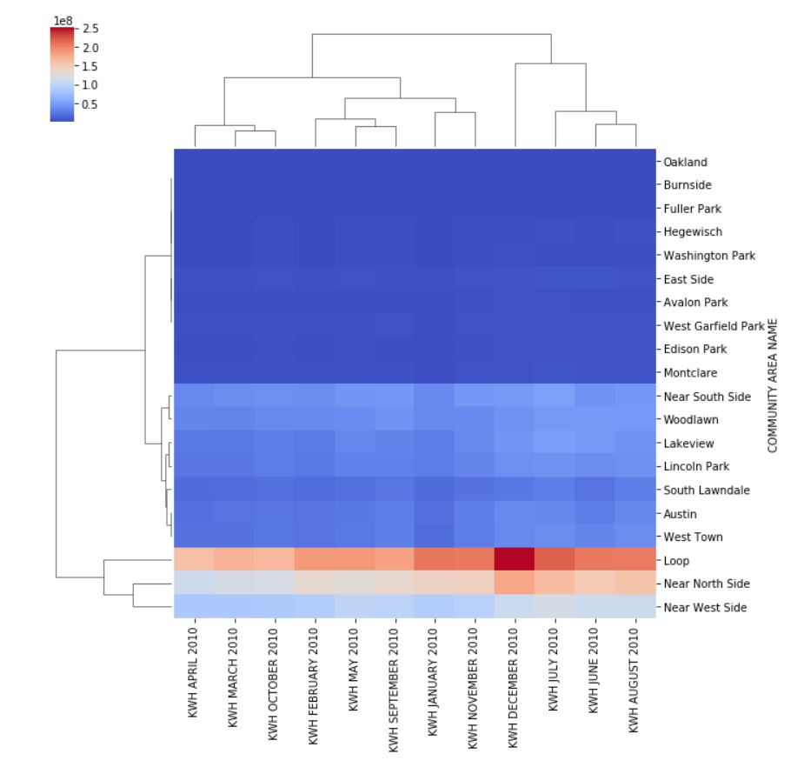
Checking for Correlation
The energy consumption in a particular
household is dependent on the city in
which that particular household or
Industry is present. This Correlation can
be found by plotting a HEATMAP.
As we can see the total energy
consumption is geography specific.

Slide 18
Hypothesis Testing
mA≠mBHa:mA≠mB
mA≠mBHa:mA≠mB
Let the Hypothesis be as follows
NULL Hypothesis H0 :
sample mean for the thermal consumption in the month of JUNE
is same as that of SEPTEMBER
mA=mB
Alternate Hypothesis H1 :
sample mean for the thermal consumption in the month of JUNE
is not same as that of SEPTEMBER
mA != mB

Slide 19
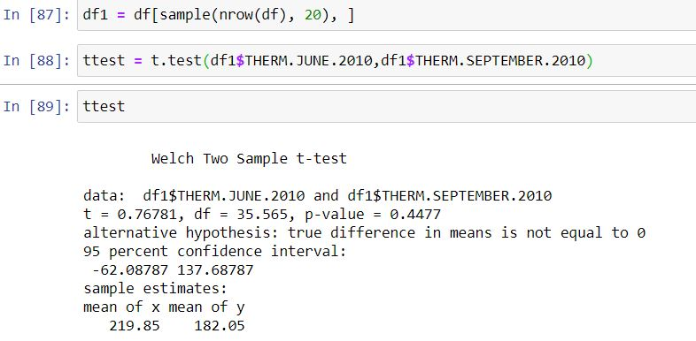
Proof for the Hypothesis Test
We will be using a t-test to check for the hypothesis

Slide 20
Conclusion
Since the p-value of the test is less than the alpha value(which is 0.05 considering the 95% significance level) , The NULL hypothesis can be rejected
Therefore we can say that the sample mean for the thermal consumption in the month of JUNE is not same as that of SEPTEMBER

